Slide 1
THE TECHNICAL COLLEGE OF LY TU TRONG
  Faculty of IT
  Ho Chi Minh City, September 2017

Slide 2
INTRODUCTION
  Faculty of IT
Notes:
Last updated March 9th 2006
Created Spring 2003
Author: J. Maletic
General overview of Computer Science Undergraduate Program

Slide 3
CONTENT
The staffs
The departments
Facilities
Students
Majors
Output
Reward

Slide 4
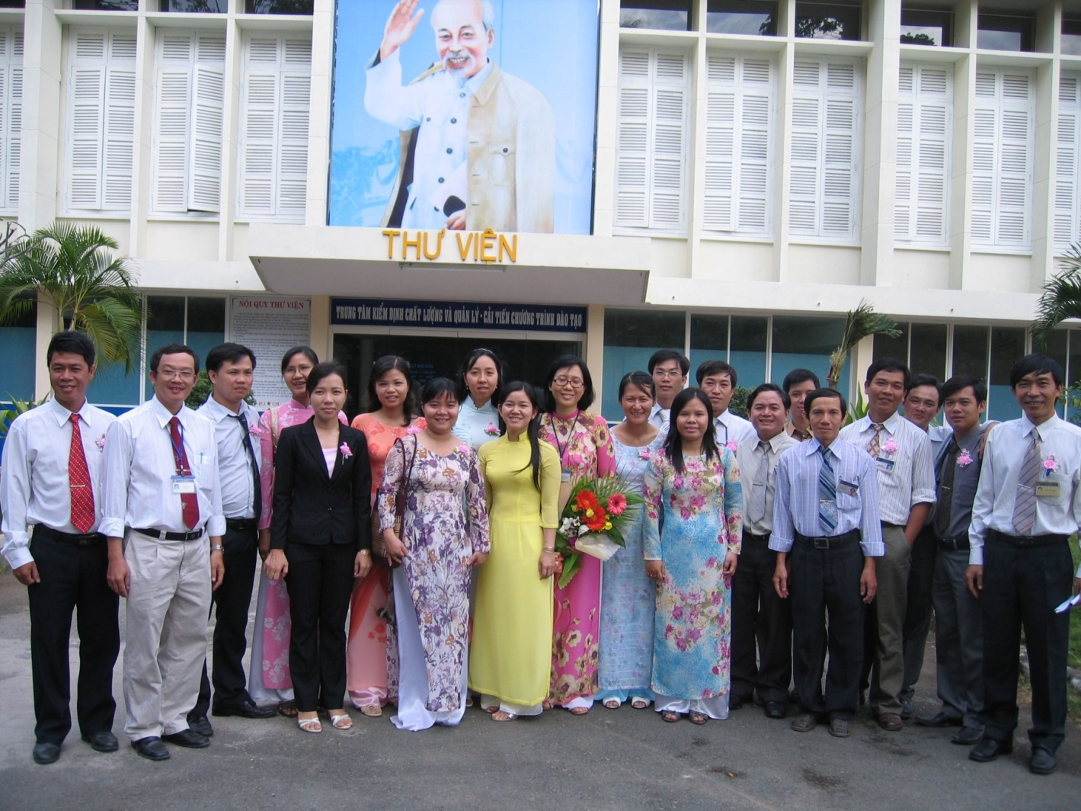
THE STAFFS

Slide 5
THE STAFFS
Lecturers |  |  | Officer
Masters |  | Bachelors | Bachelors
Graduated | Studying | Graduated | Graduated
6 | 5 | 19 | 1

Slide 6
THE DEPARTMENT
Faculty of IT
Computer and Science
Software
Network

Slide 7
REFERENCE
http://ltt.edu.vn/

